Slide 1
Minimum Spanning Tree
(Kruskal’s Algorithm)

Slide 2
Last Class’s Topic
Minimum Spanning Tree (Prim’s Algorithm)
  What is spanning tree & Minimum spanning tree?
  What will happen if we add an edge in a minimum spanning tree?

Slide 3
Kruskal's Algorithm
Edge based algorithm
Add the edges one at a time, in increasing weight order
The algorithm maintains A – a forest of trees. An edge is accepted it if connects vertices of distinct trees

Slide 4
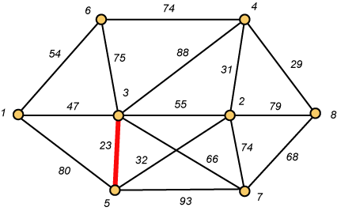
Kruskal – Step 1

Slide 5
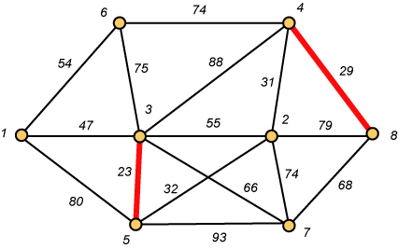
Kruskal – Step 2

Slide 6
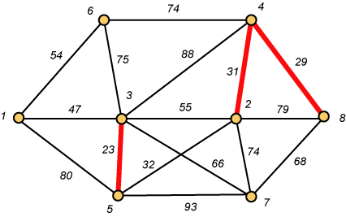
Kruskal – Step 3

Slide 7
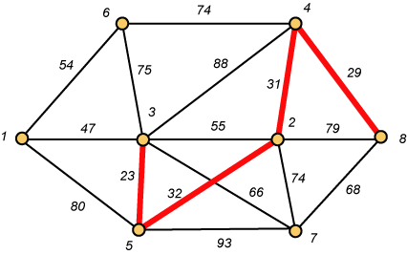
Kruskal – Step 4

Slide 8
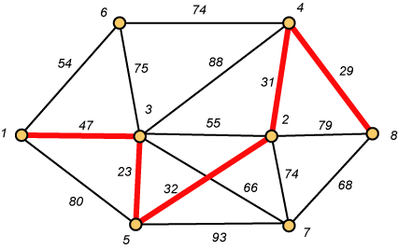
Kruskal – Step 5

Slide 9
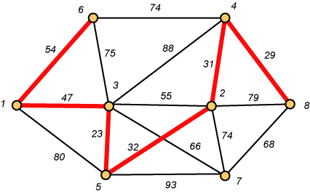
Kruskal – Step 6

Slide 10
Why Avoiding Cycles Matters
Up to this point, we have simply taken the edges in order of their weight. But now we will have to reject an edge since it forms a cycle when added to those already chosen.

Slide 11
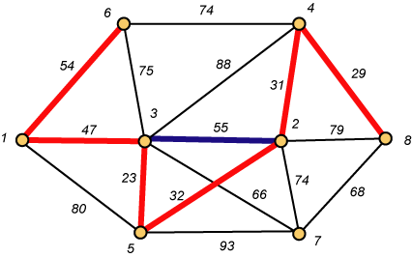
Forms a Cycle
So we cannot take the blue edge having weight 55.

Slide 12
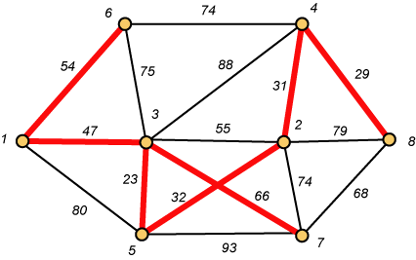
Kruskal – Step 7 DONE!!
Weight (T) = 23 + 29 + 31 + 32 + 47 + 54 + 66 = 282

